Slide 1
Rendering PowerPoint Presentations with R Markdown
An Introduction

Slide 2
Why would you want to create a PowerPoint presentation from R Markdown?

Slide 3
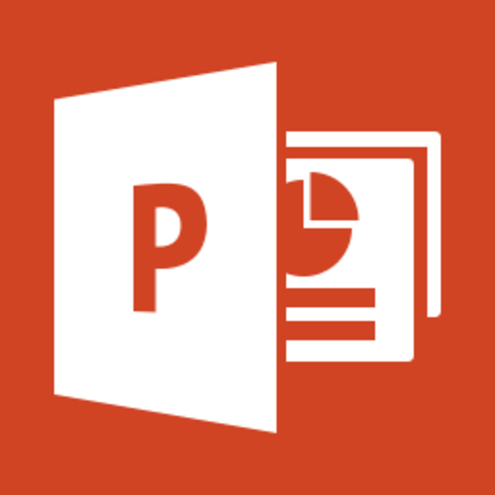
Everyone knows PowerPoint
Standard communication tool
Especially in business
People “speak” PowerPoint
Bullet points
It’s useful – it works
Flexible enough to get the job done
You can make the slides fast or pretty
Everyone has personal experience with it
Some love it
Others hate it

Slide 4

Anyone can learn R Markdown
It is so easy!
And you can use R!
Visualizations, tables, code, etc.
Plain text
Versioned, reproducible, collaborative
Emits multiple output
HTML, PDF, Microsoft Word
but not PowerPoint … UNTIL NOW!

Slide 5

We are combining two great things
The Rheese’s Peanut Butter Cup of publishing

Slide 6
Demo: Create a PowerPoint Presentation with RStudio

Slide 7
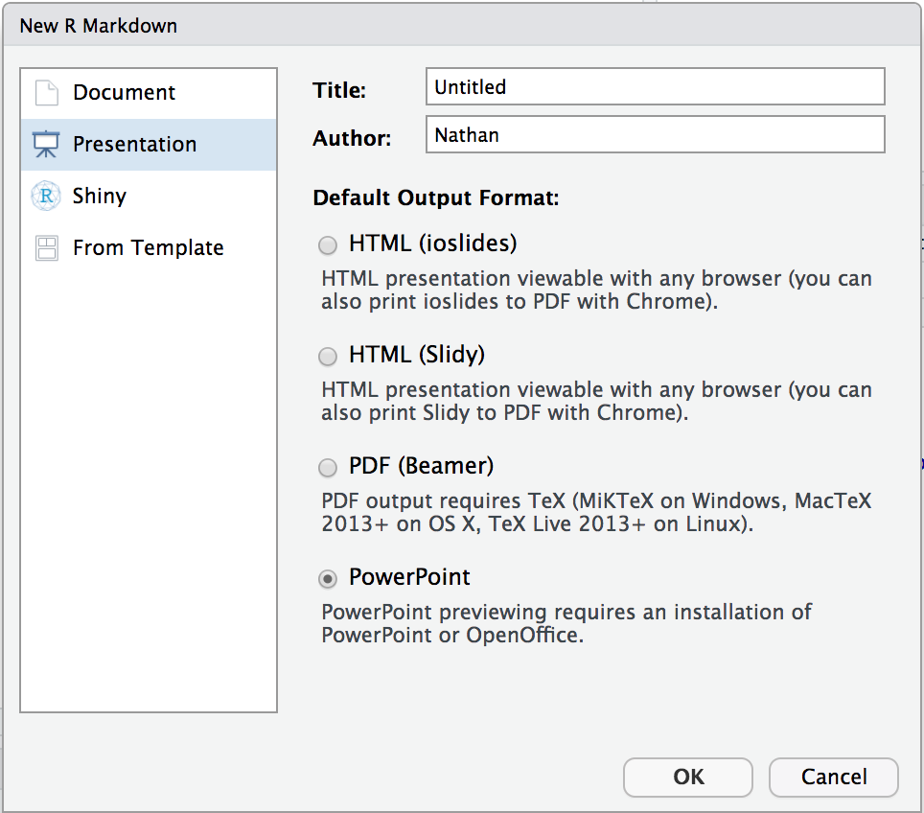
Quick Example
Create a new R Markdown Document:
File > New File > R Markdown > Presentation
Then choose:
Knit to PowerPoint
Open the presentation:
RStudio Desktop – Opens automatically
RStudio Server – Downloads automatically
You will need PowerPoint on your workstation

Slide 8
How does it work?

Slide 9
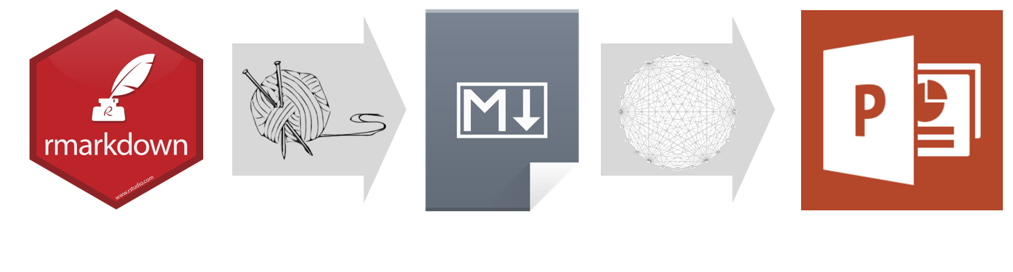
R Markdown > Markdown > Powerpoint

Slide 10

Pandoc
What is Pandoc?
Document converter (e.g. Markdown to HTML)
Free software Bundled in RStudio IDE
PowerPoint output added:
December 2017 - April 2018
Jesse Rosenthal, Johns Hopkins University
Pandoc 2.2 Features:
Markdown features
Templates
Columns
Speaker Notes
Images and Table

Slide 11
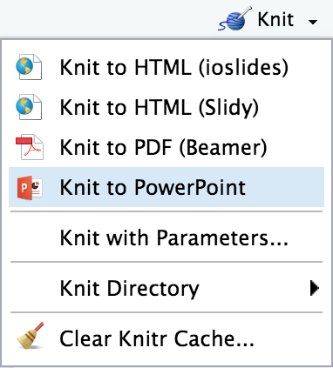
RStudio enchancements
RStudio IDE
Default template: File > New File > R Markdown
Knit to PowerPoint
Open to working slide (desktop only)
Code chunks
Includes tables and plots (e.g. ggplot)
Include webshots of HTML widgets and shiny apps
Render programmatically
IDE not required
rmarkdown::render("in.Rmd", output_format = "powerpoint_presentation")

Slide 12
Use cases
Render output and customize slides
Output visualizations of your analysis
Output ggplot
Create webshots of shiny
Programmatically render output and distribute
Weekly report

Slide 13
Using
See: rendering-powerpoint.Rmd
Demo examples and show tutorial
Where to get help?
Support.rstudio.com
rmarkdown.rstudio.com?
github repos
Publish to RSC

